Slide 1

Deep Learning Crash Course
Hui Xue
Fall 2021
www.deeplearningcrashcourse.org

Slide 2
Outline
CNN basics
Variation of convolution
Batch Normalization
CNN Examples: LeNet and Alex-Net

Slide 3
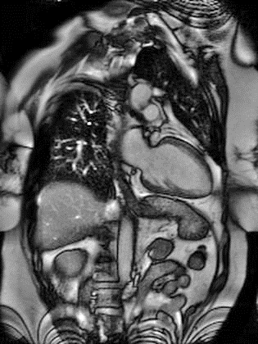
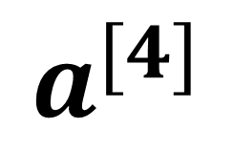

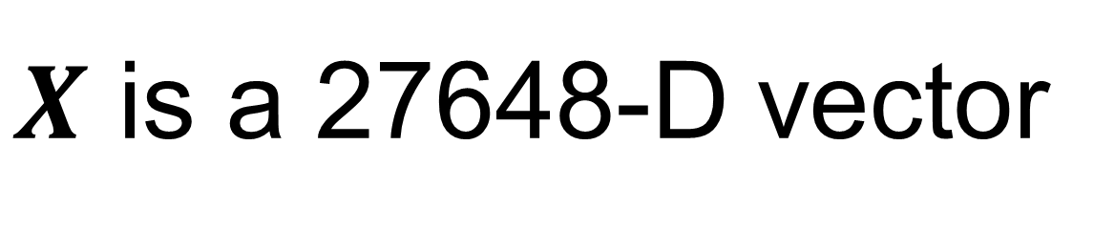
Revisit image classification
W₁^{[1]}
f
W₁^{[2]}
f
W₁^{[3]}
f
… …
… …
… …
flatten
… …
$$X$$
… …
… …
… …
W_{k}^{[1]}
f
W_{k}^{[2]}
f
W_{k}^{[3]}
f
W₁^{[4]}
f
$$a^{[4]}$$
… …
192x144x1
… …
… …
… …
#parameter?
2,764,800+100
~2.8million …
W_{N}^{[1]}
f
W_{N}^{[2]}
f
W_{N}^{[3]}
f
$X$ is a 27648-D vector
For N=100, first weight matrix has the dimension of 100x27648

Slide 4


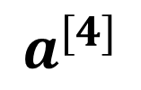
Revisit image classification
red
green
W₁^{[1]}
f
W₁^{[2]}
f
W₁^{[3]}
f
… …
… …
… …
… …
$$X$$
… …
f
… …
f
… …
f
f
W_{k}^{[1]}
W_{k}^{[2]}
W_{k}^{[3]}
W₁^{[4]}
$$a^{[4]}$$
Flatten and concatenate RGB
… …
… …
… …
… …
#parameter?
640x480x3x100+100
~92million …
640x480x3
blue
W_{N}^{[1]}
f
W_{N}^{[2]}
f
W_{N}^{[3]}
f
FC layer is not efficient for image

Slide 5
FC layer is not efficient for image
FC layer is not efficient for image
Too many parameters -> hard to train, easy to get overfitting
Treat all pixels equally; one pixel is connected to all other pixels in the image
Does not utilize the spatial information among neighboring pixels

Slide 6
Spatially invariant feature detection
Edge detection
1 | 0 | -1
2 | 0 | -2
1 | 0 | -1
1 | 2 | 1
0 | 0 | 0
-1 | -2 | -1
Use the same filter “sliding over” the image
Convolution
So no need to have different detectors for the same image features → FC method is not optimal
Sobel filter
Gradient along row
Gradient along column

Slide 7
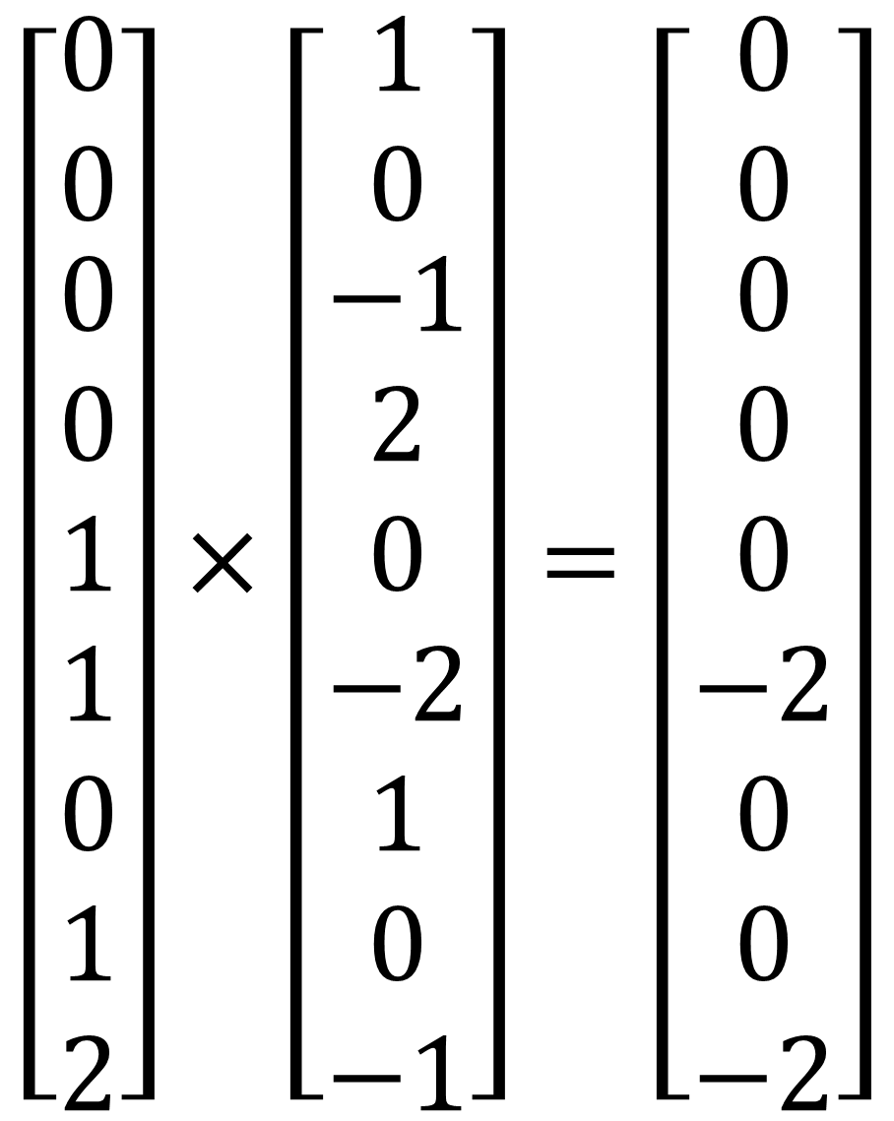
CNN is a spatial-invariant, parameter-sharing FC
Use the convolution operation for spatial invariant → spatial invariant
Use the same filter for the whole image → parameter sharing
1 | 0 | -1
2 | 0 | -2
1 | 0 | -1
$$\left[\begin{matrix}0 \\ 0 \\ \begin{aligned}0 \\ 0 \\ 1 \\ 1 \\ 0 \\ 1 \\ 2\end{aligned}\end{matrix}\right]×\left[\begin{matrix}1 \\ 0 \\ \begin{aligned}−1 \\ 2 \\ 0 \\ −2 \\ 1 \\ 0 \\ −1\end{aligned}\end{matrix}\right]=\left[\begin{matrix}0 \\ 0 \\ \begin{aligned}0 \\ 0 \\ 0 \\ −2 \\ 0 \\ 0 \\ −2\end{aligned}\end{matrix}\right]$$
0 | 0 | 0 | 0 | 0 | 0 | 0 | 0
0 | 1 | 1 | 1 | 1 | 1 | 1 | 0
0 | 1 | 2 | 2 | 2 | 2 | 1 | 0
0 | 1 | 2 | 3 | 3 | 2 | 1 | 0
0 | 1 | 2 | 3 | 3 | 2 | 1 | 0
0 | 1 | 2 | 2 | 2 | 2 | 1 | 0
0 | 1 | 1 | 1 | 1 | 1 | 1 | 0
0 | 0 | 0 | 0 | 0 | 0 | 0 | 0
-4
sum(.)

Slide 8
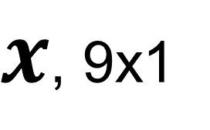
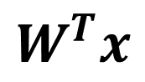
CNN is a spatial-invariant, parameter-sharing FC
Use the convolution operation for spatial invariant → spatial invariant
Use the same filter for the whole image → parameter sharing
1 | 0 | -1
2 | 0 | -2
1 | 0 | -1
0 | 0 | 0 | 0 | 0 | 0 | 0 | 0
0 | 1 | 1 | 1 | 1 | 1 | 1 | 0
0 | 1 | 2 | 2 | 2 | 2 | 1 | 0
0 | 1 | 2 | 3 | 3 | 2 | 1 | 0
0 | 1 | 2 | 3 | 3 | 2 | 1 | 0
0 | 1 | 2 | 2 | 2 | 2 | 1 | 0
0 | 1 | 1 | 1 | 1 | 1 | 1 | 0
0 | 0 | 0 | 0 | 0 | 0 | 0 | 0
$x$, 9x1
-4
$$W^{T}x$$
Take a neighborhood and flatten
Multiple with kernel and sum it up
Can be seen as a local FC

Slide 9
CNN is a spatial-invariant, parameter-sharing FC
Use the convolution operation for spatial invariant → spatial invariant
Use the same filter for the whole image → parameter sharing
1 | 0 | -1
2 | 0 | -2
1 | 0 | -1
0 | 0 | 0 | 0 | 0 | 0 | 0 | 0
0 | 1 | 1 | 1 | 1 | 1 | 1 | 0
0 | 1 | 2 | 2 | 2 | 2 | 1 | 0
0 | 1 | 2 | 3 | 3 | 2 | 1 | 0
0 | 1 | 2 | 3 | 3 | 2 | 1 | 0
0 | 1 | 2 | 2 | 2 | 2 | 1 | 0
0 | 1 | 1 | 1 | 1 | 1 | 1 | 0
0 | 0 | 0 | 0 | 0 | 0 | 0 | 0
$x$, 9x1
-4 | -1
$$W^{T}x$$

Slide 10
CNN is a spatial-invariant, parameter-sharing FC
Use the convolution operation for spatial invariant → spatial invariant
Use the same filter for the whole image → parameter sharing
1 | 0 | -1
2 | 0 | -2
1 | 0 | -1
0 | 0 | 0 | 0 | 0 | 0 | 0 | 0
0 | 1 | 1 | 1 | 1 | 1 | 1 | 0
0 | 1 | 2 | 2 | 2 | 2 | 1 | 0
0 | 1 | 2 | 3 | 3 | 2 | 1 | 0
0 | 1 | 2 | 3 | 3 | 2 | 1 | 0
0 | 1 | 2 | 2 | 2 | 2 | 1 | 0
0 | 1 | 1 | 1 | 1 | 1 | 1 | 0
0 | 0 | 0 | 0 | 0 | 0 | 0 | 0
$x$, 9x1
-4 | -1 | 0
$$W^{T}x$$

Slide 11
CNN is a spatial-invariant, parameter-sharing FC
Use the convolution operation for spatial invariant → spatial invariant
Use the same filter for the whole image → parameter sharing
1 | 0 | -1
2 | 0 | -2
1 | 0 | -1
0 | 0 | 0 | 0 | 0 | 0 | 0 | 0
0 | 1 | 1 | 1 | 1 | 1 | 1 | 0
0 | 1 | 2 | 2 | 2 | 2 | 1 | 0
0 | 1 | 2 | 3 | 3 | 2 | 1 | 0
0 | 1 | 2 | 3 | 3 | 2 | 1 | 0
0 | 1 | 2 | 2 | 2 | 2 | 1 | 0
0 | 1 | 1 | 1 | 1 | 1 | 1 | 0
0 | 0 | 0 | 0 | 0 | 0 | 0 | 0
$x$, 9x1
-4 | -1 | 0 | 0
$$W^{T}x$$

Slide 12
CNN is a spatial-invariant, parameter-sharing FC
Use the convolution operation for spatial invariant → spatial invariant
Use the same filter for the whole image → parameter sharing
1 | 0 | -1
2 | 0 | -2
1 | 0 | -1
0 | 0 | 0 | 0 | 0 | 0 | 0 | 0
0 | 1 | 1 | 1 | 1 | 1 | 1 | 0
0 | 1 | 2 | 2 | 2 | 2 | 1 | 0
0 | 1 | 2 | 3 | 3 | 2 | 1 | 0
0 | 1 | 2 | 3 | 3 | 2 | 1 | 0
0 | 1 | 2 | 2 | 2 | 2 | 1 | 0
0 | 1 | 1 | 1 | 1 | 1 | 1 | 0
0 | 0 | 0 | 0 | 0 | 0 | 0 | 0
$x$, 9x1
-4 | -1 | 0 | 0 | 1
$$W^{T}x$$

Slide 13
CNN is a spatial-invariant, parameter-sharing FC
Use the convolution operation for spatial invariant → spatial invariant
Use the same filter for the whole image → parameter sharing
1 | 0 | -1
2 | 0 | -2
1 | 0 | -1
0 | 0 | 0 | 0 | 0 | 0 | 0 | 0
0 | 1 | 1 | 1 | 1 | 1 | 1 | 0
0 | 1 | 2 | 2 | 2 | 2 | 1 | 0
0 | 1 | 2 | 3 | 3 | 2 | 1 | 0
0 | 1 | 2 | 3 | 3 | 2 | 1 | 0
0 | 1 | 2 | 2 | 2 | 2 | 1 | 0
0 | 1 | 1 | 1 | 1 | 1 | 1 | 0
0 | 0 | 0 | 0 | 0 | 0 | 0 | 0
$x$, 9x1
-4 | -1 | 0 | 0 | 1 | 4
$$W^{T}x$$

Slide 14
CNN is a spatial-invariant, parameter-sharing FC
Use the convolution operation for spatial invariant → spatial invariant
Use the same filter for the whole image → parameter sharing
1 | 0 | -1
2 | 0 | -2
1 | 0 | -1
0 | 0 | 0 | 0 | 0 | 0 | 0 | 0
0 | 1 | 1 | 1 | 1 | 1 | 1 | 0
0 | 1 | 2 | 2 | 2 | 2 | 1 | 0
0 | 1 | 2 | 3 | 3 | 2 | 1 | 0
0 | 1 | 2 | 3 | 3 | 2 | 1 | 0
0 | 1 | 2 | 2 | 2 | 2 | 1 | 0
0 | 1 | 1 | 1 | 1 | 1 | 1 | 0
0 | 0 | 0 | 0 | 0 | 0 | 0 | 0
$x$, 9x1
-4 | -1 | 0 | 0 | 1 | 4
-7
$$W^{T}x$$

Slide 15
CNN is a spatial-invariant, parameter-sharing FC
Use the convolution operation for spatial invariant → spatial invariant
Use the same filter for the whole image → parameter sharing
1 | 0 | -1
2 | 0 | -2
1 | 0 | -1
0 | 0 | 0 | 0 | 0 | 0 | 0 | 0
0 | 1 | 1 | 1 | 1 | 1 | 1 | 0
0 | 1 | 2 | 2 | 2 | 2 | 1 | 0
0 | 1 | 2 | 3 | 3 | 2 | 1 | 0
0 | 1 | 2 | 3 | 3 | 2 | 1 | 0
0 | 1 | 2 | 2 | 2 | 2 | 1 | 0
0 | 1 | 1 | 1 | 1 | 1 | 1 | 0
0 | 0 | 0 | 0 | 0 | 0 | 0 | 0
$x$, 9x1
-4 | -1 | 0 | 0 | 1 | 4
-7 | -4
$$W^{T}x$$

Slide 16
CNN is a spatial-invariant, parameter-sharing FC
Use the convolution operation for spatial invariant → spatial invariant
Use the same filter for the whole image → parameter sharing
1 | 0 | -1
2 | 0 | -2
1 | 0 | -1
0 | 0 | 0 | 0 | 0 | 0 | 0 | 0
0 | 1 | 1 | 1 | 1 | 1 | 1 | 0
0 | 1 | 2 | 2 | 2 | 2 | 1 | 0
0 | 1 | 2 | 3 | 3 | 2 | 1 | 0
0 | 1 | 2 | 3 | 3 | 2 | 1 | 0
0 | 1 | 2 | 2 | 2 | 2 | 1 | 0
0 | 1 | 1 | 1 | 1 | 1 | 1 | 0
0 | 0 | 0 | 0 | 0 | 0 | 0 | 0
$x$, 9x1
-4 | -1 | 0 | 0 | 1 | 4
-7 | -4 | -1 | 1 | 4 | 7
-8 | -7 | -3 | 3 | 7 | 8
-8 | -7 | -3 | 3 | 7 | 8
-7 | -4 | -1 | 1 | 4 | 7
-4 | -1 | 0 | 0 | 1 | 4
$$W^{T}x$$

Slide 17
CNN is a spatial-invariant, parameter-sharing FC
Use the convolution operation for spatial invariant → spatial invariant
Use the same filter for the whole image → parameter sharing
1 | 0 | -1
2 | 0 | -2
1 | 0 | -1
0 | 0 | 0 | 0 | 0 | 0 | 0 | 0
0 | 1 | 1 | 1 | 1 | 1 | 1 | 0
0 | 1 | 2 | 2 | 2 | 2 | 1 | 0
0 | 1 | 2 | 3 | 3 | 2 | 1 | 0
0 | 1 | 2 | 3 | 3 | 2 | 1 | 0
0 | 1 | 2 | 2 | 2 | 2 | 1 | 0
0 | 1 | 1 | 1 | 1 | 1 | 1 | 0
0 | 0 | 0 | 0 | 0 | 0 | 0 | 0
Higher value in outputs indicate “vertical edges”
With direction information (gradient direction)
$x$, 9x1
-4 | -1 | 0 | 0 | 1 | 4
-7 | -4 | -1 | 1 | 4 | 7
-8 | -7 | -3 | 3 | 7 | 8
-8 | -7 | -3 | 3 | 7 | 8
-7 | -4 | -1 | 1 | 4 | 7
-4 | -1 | 0 | 0 | 1 | 4
$$W^{T}x$$

Slide 18
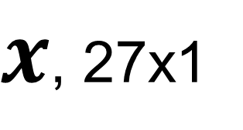

CNN layer with multiple channels
Kernel has multiple channels too
Sum over all channels
Image: $H×W×C$
Kernel: $k_{x}×k_{y}×C$
1 | 0 | -1
2 | 0 | -2
1 | 0 | -1
0 | 0 | 0 | 0 | 0 | 0 | 0 | 0
0 | 1 | 1 | 1 | 1 | 1 | 1 | 0
0 | 1 | 2 | 2 | 2 | 2 | 1 | 0
0 | 1 | 2 | 3 | 3 | 2 | 1 | 0
0 | 1 | 2 | 3 | 3 | 2 | 1 | 0
0 | 1 | 2 | 2 | 2 | 2 | 1 | 0
0 | 1 | 1 | 1 | 1 | 1 | 1 | 0
0 | 0 | 0 | 0 | 0 | 0 | 0 | 0
$x$, 27x1
0
$$W^{T}x$$

Slide 19
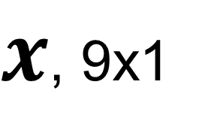
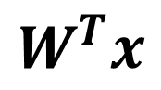
Padding
Pixels on the boundary was not explored
Reduced output size
1 | 0 | -1
2 | 0 | -2
1 | 0 | -1
Padding = 1
 |  |  | 0 | 0 | 0 | 0 | 0 | 0 | 0
 | 0 | 0 | 0 | 0 | 0 | 0 | 0 | 0 | 0
 | 0 | 1 | 1 | 1 | 1 | 1 | 1 | 0 | 0
0 | 0 | 1 | 2 | 2 | 2 | 2 | 1 | 0 | 0
0 | 0 | 1 | 2 | 3 | 3 | 2 | 1 | 0 | 0
0 | 0 | 1 | 2 | 3 | 3 | 2 | 1 | 0 | 0
0 | 0 | 1 | 2 | 2 | 2 | 2 | 1 | 0 | 0
0 | 0 | 1 | 1 | 1 | 1 | 1 | 1 | 0 | 0
0 | 0 | 0 | 0 | 0 | 0 | 0 | 0 | 0 | 0
0 | 0 | 0 | 0 | 0 | 0 | 0 | 0 | 0 | 0
0 | 0 | 0
0
0
-1 | -1 | 0 | 0 | 0 | 0 | 1 | 1
-3 | -4 | -1 | 0 | 0 | 1 | 4 | -3
-4 | -7 | -4 | -1 | 1 | 4 | 7 | -4
-4 | -8 | -7 | -3 | 3 | 7 | 8 | -4
-4 | -8 | -7 | -3 | 3 | 7 | 8 | -4
-4 | -7 | -4 | -1 | 1 | 4 | 7 | -4
-3 | -4 | -1 | 0 | 0 | 1 | 4 | -3
-1 | -1 | 0 | 0 | 0 | 0 | 1 | 1
$x$, 9x1
$$W^{T}x$$
Often pad with 0
Other choices : replica, mirror, periodic

Slide 20
Stride
When sliding the kernel over the image, the moving stepsize is the stride
Default is 1, but stride can be larger than 1
Often used to reduce output size
Stride=2 along row
0 | 0 | 0 | 0 | 0 | 0 | 0 | 0
0 | 1 | 1 | 1 | 1 | 1 | 1 | 0
0 | 1 | 2 | 2 | 2 | 2 | 1 | 0
0 | 1 | 2 | 3 | 3 | 2 | 1 | 0
0 | 1 | 2 | 3 | 3 | 2 | 1 | 0
0 | 1 | 2 | 2 | 2 | 2 | 1 | 0
0 | 1 | 1 | 1 | 1 | 1 | 1 | 0
0 | 0 | 0 | 0 | 0 | 0 | 0 | 0
$x$, 9x1
-4 |  | 0
$$W^{T}x$$

Slide 21
Stride
When sliding the kernel over the image, the moving stepsize is the stride
Default is 1, but stride can be larger than 1
Often used to reduce output size
Stride=2 along column
0 | 0 | 0 | 0 | 0 | 0 | 0 | 0
0 | 1 | 1 | 1 | 1 | 1 | 1 | 0
0 | 1 | 2 | 2 | 2 | 2 | 1 | 0
0 | 1 | 2 | 3 | 3 | 2 | 1 | 0
0 | 1 | 2 | 3 | 3 | 2 | 1 | 0
0 | 1 | 2 | 2 | 2 | 2 | 1 | 0
0 | 1 | 1 | 1 | 1 | 1 | 1 | 0
0 | 0 | 0 | 0 | 0 | 0 | 0 | 0
$x$, 9x1
-4
-8
$$W^{T}x$$

Slide 22
Stride
When sliding the kernel over the image, the moving stepsize is the stride
Default is 1, but stride can be larger than 1
Often used to reduce output size
Input 8x8
Kernel 3x3
Output 3x3
With padding=0, stride=2 for H and W
0 | 0 | 0 | 0 | 0 | 0 | 0 | 0
0 | 1 | 1 | 1 | 1 | 1 | 1 | 0
0 | 1 | 2 | 2 | 2 | 2 | 1 | 0
0 | 1 | 2 | 3 | 3 | 2 | 1 | 0
0 | 1 | 2 | 3 | 3 | 2 | 1 | 0
0 | 1 | 2 | 2 | 2 | 2 | 1 | 0
0 | 1 | 1 | 1 | 1 | 1 | 1 | 0
0 | 0 | 0 | 0 | 0 | 0 | 0 | 0
$x$, 9x1
-4 |  | 0 |  | 1
-8 |  | -3 |  | 7
-7 |  | -1 |  | 4
$$W^{T}x$$

Slide 23
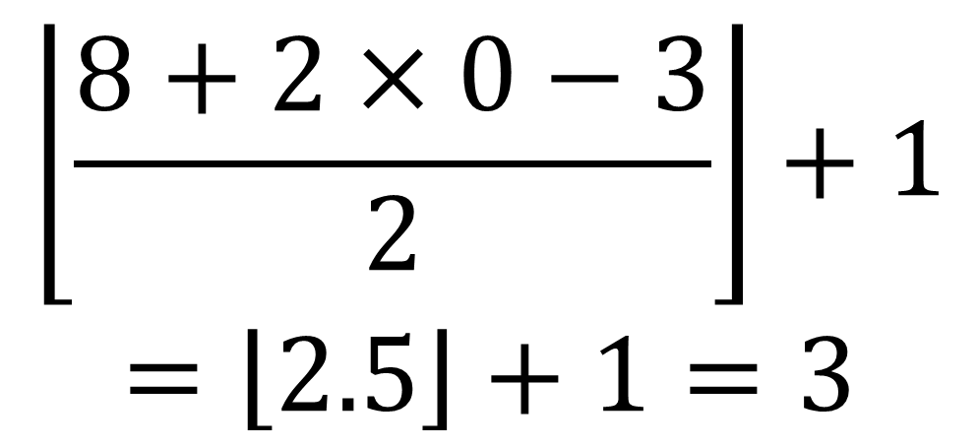
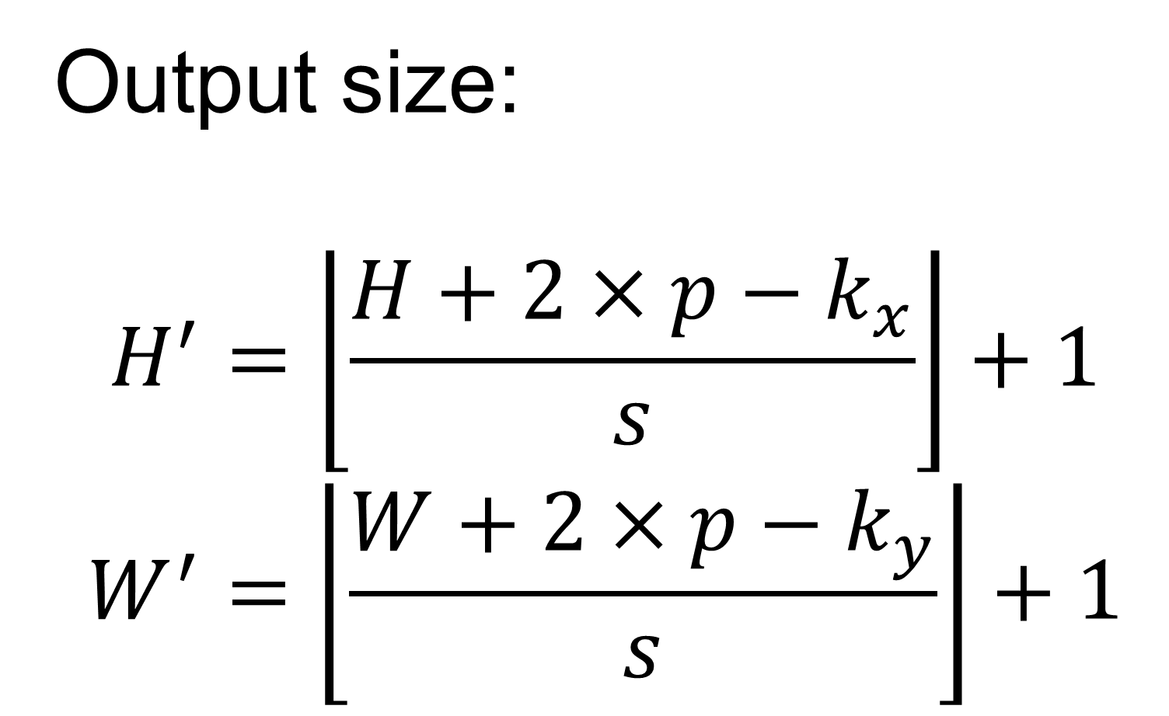
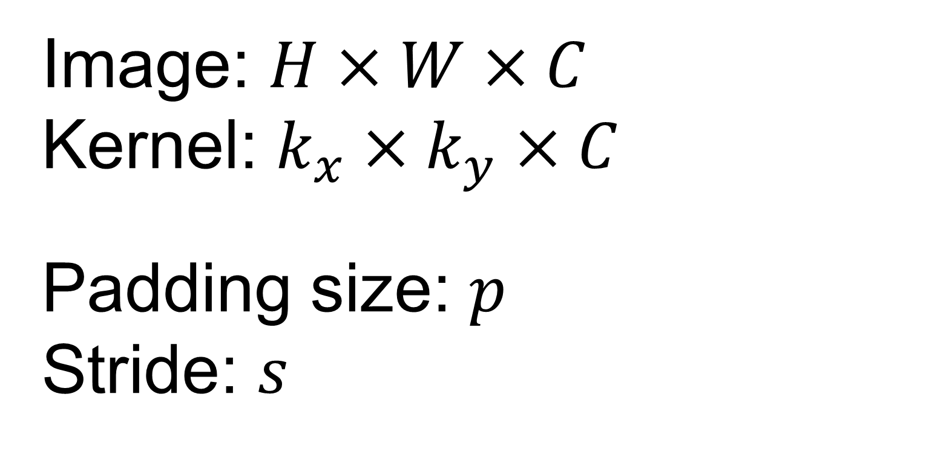
Determine the output size
Output size:
$$H^{′}=\left\lfloor \left.\frac{H+2×p−k_{x}}{s}\right\rfloor \right.+1$$
$$W^{′}=\left\lfloor \left.\frac{W+2×p−k_{y}}{s}\right\rfloor \right.+1$$
Image: $H×W×C$
Kernel: $k_{x}×k_{y}×C$
Padding size: $p$
Stride: $s$
$$\left\lfloor \left.\frac{8+2×0−3}{2}\right\rfloor \right.+1$$
$$=\left\lfloor \left.2.5\right\rfloor \right.+1=3$$
0 | 0 | 0 | 0 | 0 | 0 | 0 | 0
0 | 1 | 1 | 1 | 1 | 1 | 1 | 0
0 | 1 | 2 | 2 | 2 | 2 | 1 | 0
0 | 1 | 2 | 3 | 3 | 2 | 1 | 0
0 | 1 | 2 | 3 | 3 | 2 | 1 | 0
0 | 1 | 2 | 2 | 2 | 2 | 1 | 0
0 | 1 | 1 | 1 | 1 | 1 | 1 | 0
0 | 0 | 0 | 0 | 0 | 0 | 0 | 0
$x$, 9x1
-4 |  | 0 |  | 1
-8 |  | -3 |  | 7
-7 |  | -1 |  | 4
Stride can be used to reduce image size
$$W^{T}x$$

Slide 24
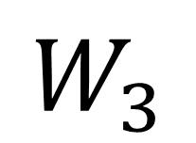
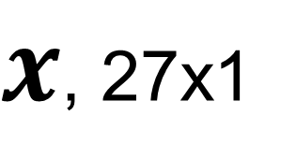
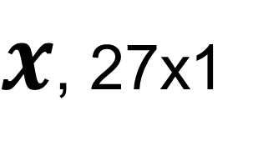
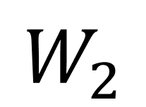
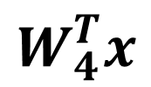
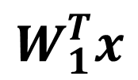
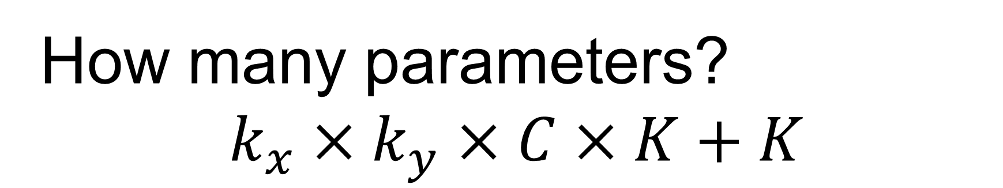

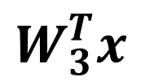
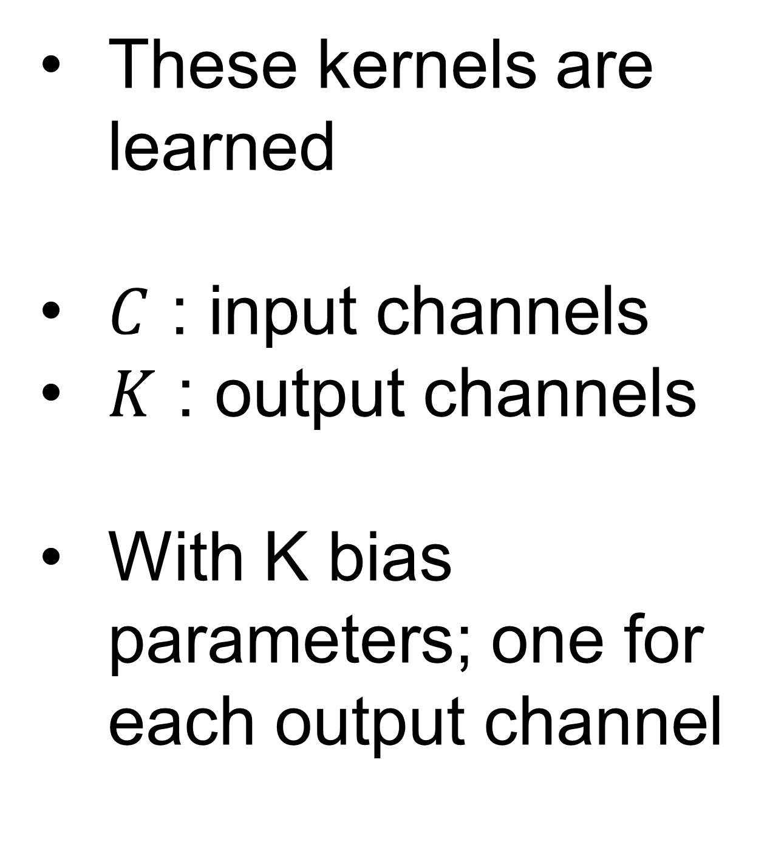
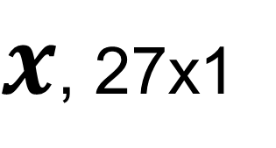
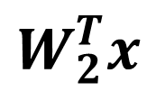
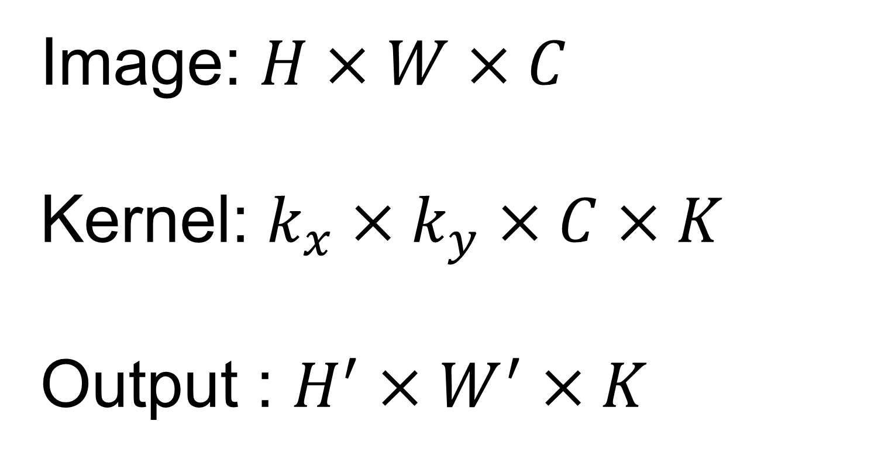
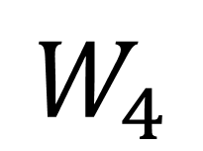
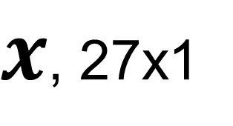
Multiple kernels
For one location in the image, multiple kernels can be used to capture different features
Image: $H×W×C$
Kernel: $k_{x}×k_{y}×C×K$
Output : $H^{′}×W^{′}×K$
1 | 0 | -1
2 | 0 | -2
1 | 0 | -1
1 | 2 | 1
0 | 0 | 0
-1 | -2 | -1
1 | 0 | 0
0 | 1 | 0
0 | 0 | 1
1 | 1 | 0
1 | 0 | 0
0 | 0 | 0
$$W_{1}$$
$$W_{2}$$
$$W_{3}$$
$$W_{4}$$
These kernels are learned
$C$ : input channels
$K$ : output channels
With K bias parameters; one for each output channel
0 | 0 | 0 | 0 | 0 | 0 | 0 | 0
0 | 1 | 1 | 1 | 1 | 1 | 1 | 0
0 | 1 | 2 | 2 | 2 | 2 | 1 | 0
0 | 1 | 2 | 3 | 3 | 2 | 1 | 0
0 | 1 | 2 | 3 | 3 | 2 | 1 | 0
0 | 1 | 2 | 2 | 2 | 2 | 1 | 0
0 | 1 | 1 | 1 | 1 | 1 | 1 | 0
0 | 0 | 0 | 0 | 0 | 0 | 0 | 0
$x$, 27x1
$$W_{1}^{T}x$$
$x$, 27x1
$$W_{2}^{T}x$$
Feature maps
$x$, 27x1
$x$, 27x1
$$W_{3}^{T}x$$
$$W_{4}^{T}x$$
How many parameters?
$$k_{x}×k_{y}×C×K+K$$

Slide 25
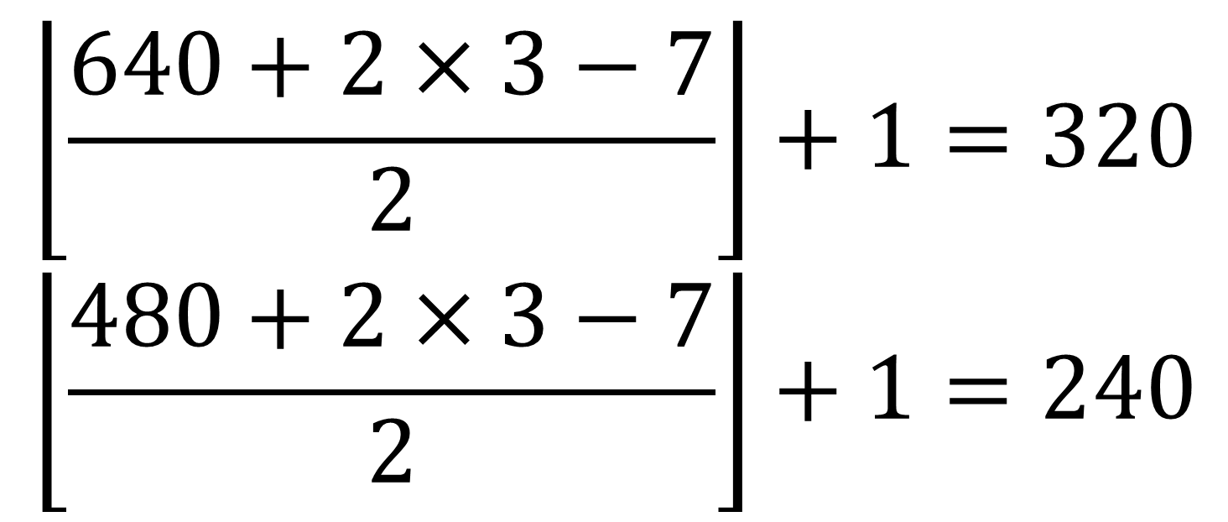
Multiple CONV layers can be stacked
Nonlinearity (e.g. ReLU) is applied to every element on feature maps
$$\left\lfloor \left.\frac{640+2×3−7}{2}\right\rfloor \right.+1=320$$
$$\left\lfloor \left.\frac{480+2×3−7}{2}\right\rfloor \right.+1=240$$
3x640x480
Kernel: 7x7x3x16,
16 biases
CONV
7x7, p=3, s=2, K=16
16x320x240
Total number of parameters:
7x7x3x16+16+5x5x16x32+32+3x3x32x64+64+256x307200+256+1x256+1 = 78,677409, ~78million
One FC layer claims 99.96%
ReLU
16x320x240
logit
Kernel: 5x5x16x32,
32 biases
W: 1x256,
1 biases
CONV
5x5, p=2, s=2 , K=32
FC, D=1
32x160x120
256x1
ReLU
32x160x120
Kernel: 3x3x32x64,
64 biases
ReLU
W: 256x307200,
256 biases
FC, D=256
CONV
3x3, p=1, s=2 , K=64
64x80x60
307200x1
ReLU
Flatten
64x80x60

Slide 26
Receptive field
Every CONV filter looks at a small neighborhood
May need to look at more global structure in the image?
Receptive field : the region in the image to impact a feature after some CONV layers
8x8x3
Kernel:
3x3x1, p=0, s=1
Kernel:
3x3x1, p=0, s=1
0 | 0 | 0 | 0 | 0 | 0 | 0 | 0
0 | 1 | 1 | 1 | 1 | 1 | 1 | 0
0 | 1 | 2 | 2 | 2 | 2 | 1 | 0
0 | 1 | 2 | 3 | 3 | 2 | 1 | 0
0 | 1 | 2 | 3 | 3 | 2 | 1 | 0
0 | 1 | 2 | 2 | 2 | 2 | 1 | 0
0 | 1 | 1 | 1 | 1 | 1 | 1 | 0
0 | 0 | 0 | 0 | 0 | 0 | 0 | 0
With deeper network, the receptive field increases

Slide 27
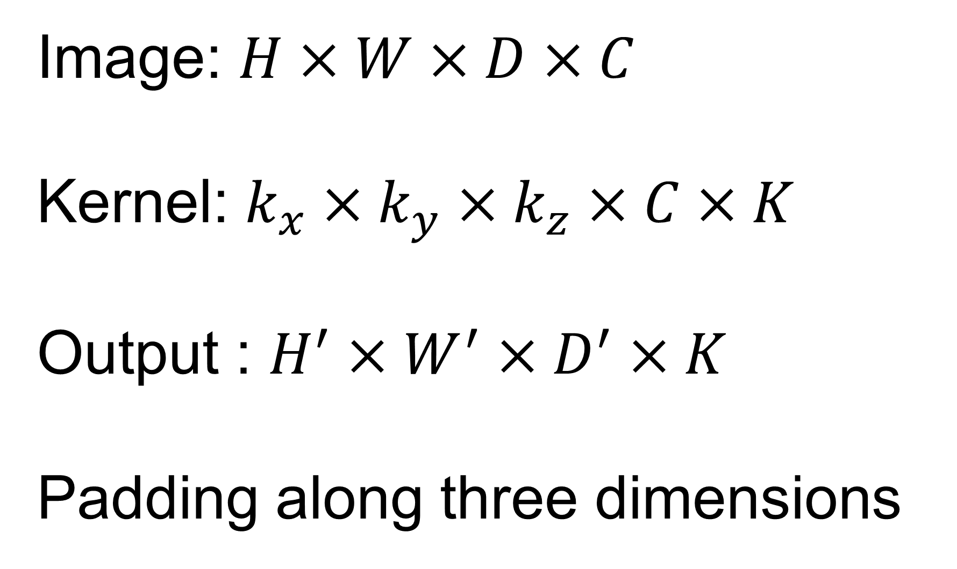
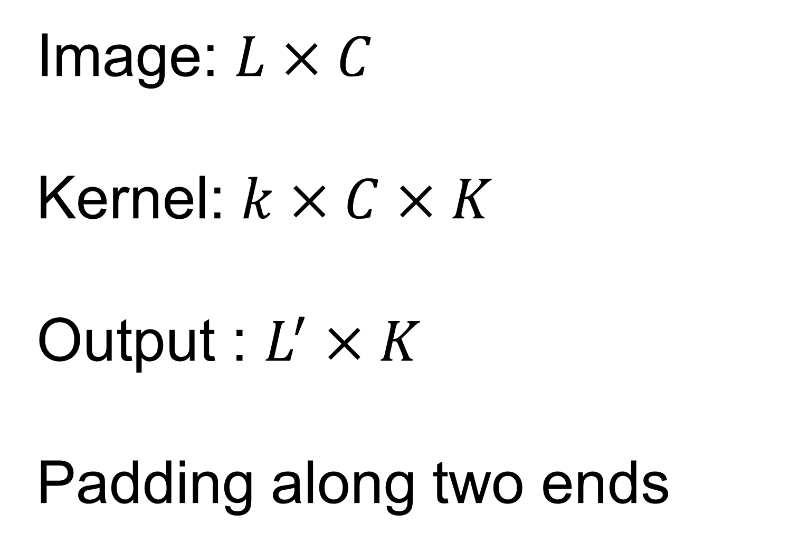
1D and 3D convolution
Computation is the same as the 2D CONV
0 | 0 | 0 | 0 | 0 | 0 | 0 | 0
0 | 1 | 1 | 1 | 1 | 1 | 1 | 0
0 | 1 | 2 | 2 | 2 | 2 | 1 | 0
0 | 1 | 2 | 3 | 3 | 2 | 1 | 0
0 | 1 | 2 | 3 | 3 | 2 | 1 | 0
0 | 1 | 2 | 2 | 2 | 2 | 1 | 0
0 | 1 | 1 | 1 | 1 | 1 | 1 | 0
0 | 0 | 0 | 0 | 0 | 0 | 0 | 0
1 | 0 | -1
0 | 1 | 2 | 3 | 3 | 2 | 1 | 0
Image: $H×W×D×C$
Kernel: $k_{x}×k_{y}×k_{z}×C×K$
Output : $H^{′}×W^{′}×D^{′}×K$
Padding along three dimensions
Image: $L×C$
Kernel: $k×C×K$
Output : $L^{′}×K$
Padding along two ends

Slide 28

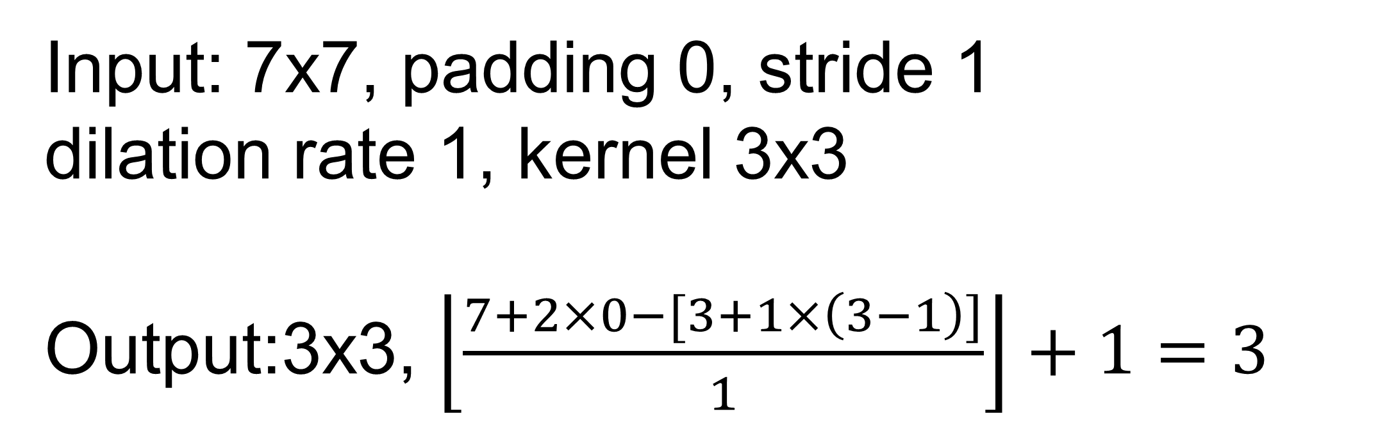
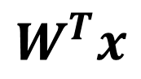
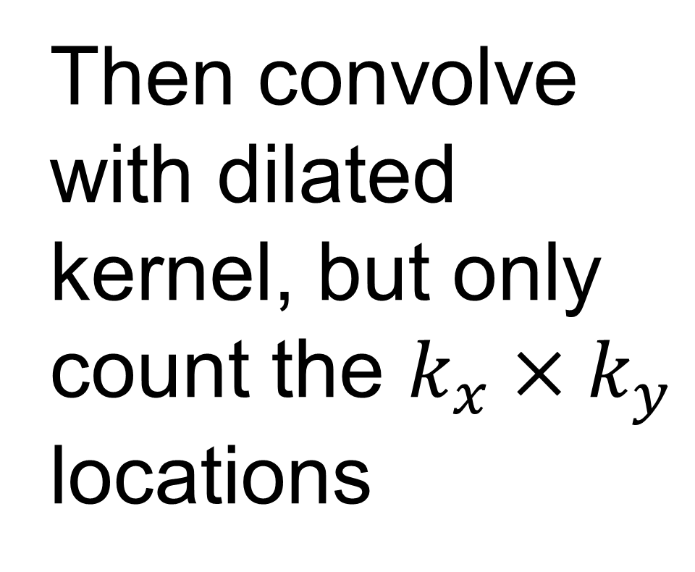
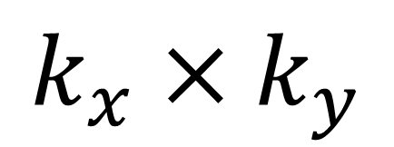
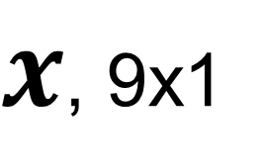
Dilated convolution
Increase receptive field by “skipping pixels” in input images
$$k_{x}×k_{y}$$
Dilate kernel with the dilation rate 1
$$[k_{x}+d\left(k_{x}−1\right)]×[k_{y}+d\left(k_{y}−1\right)]$$
1 |  | 0 |  | -1
2 |  | 0 |  | -2
1 |  | 0 |  | -1
1 | 0 | -1
2 | 0 | -2
1 | 0 | -1
0 | 0 | 0 | 0 | 0 | 0 | 0 | 0
0 | 1 | 1 | 1 | 1 | 1 | 1 | 0
0 | 1 | 2 | 2 | 2 | 2 | 1 | 0
0 | 1 | 2 | 3 | 3 | 2 | 1 | 0
0 | 1 | 2 | 3 | 3 | 2 | 1 | 0
0 | 1 | 2 | 2 | 2 | 2 | 1 | 0
0 | 1 | 1 | 1 | 1 | 1 | 1 | 0
0 | 0 | 0 | 0 | 0 | 0 | 0 | 0
[1 1 1 1 3 2 1 2 2]
X
[1 0 -1 2 0 -2 1 0 -1]^{T} = -3
$x$, 9x1
$$W^{T}x$$
Then convolve with dilated kernel, but only count the $k_{x}×k_{y}$ locations
Input: 7x7, padding 0, stride 1
dilation rate 1, kernel 3x3
Output:3x3, $\left\lfloor \frac{7+2×0−[3+1×\left(3−1\right)]}{1}\right\rfloor +1=3$
Animation is from https://github.com/vdumoulin/conv_arithmetic

Slide 29

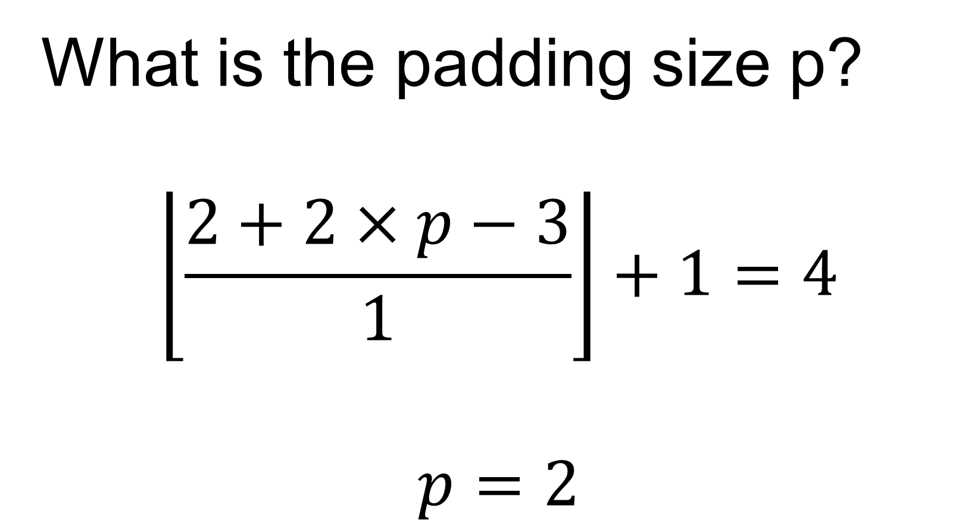
Transpose convolution
Increase image size after convolution – often used to upsample feature maps
Input: 2x2, padding 0, stride 1
Kernel: 3x3
Required Output:4x4
Determine padding size
Sliding over the output
For every location in output, take the corresponding pixels in input maps and apply the kernel
What is the padding size p?
$$\left\lfloor \frac{2+2×p−3}{1}\right\rfloor +1=4$$
$$p=2$$
Animation is from https://github.com/vdumoulin/conv_arithmetic

Slide 30
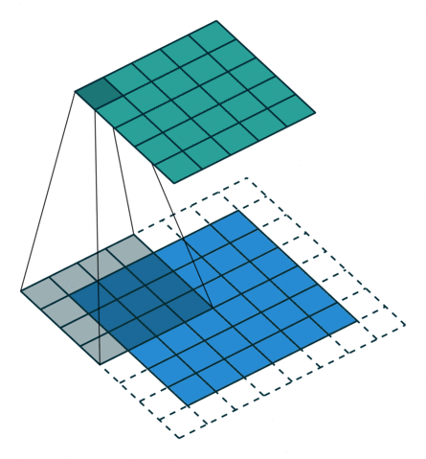
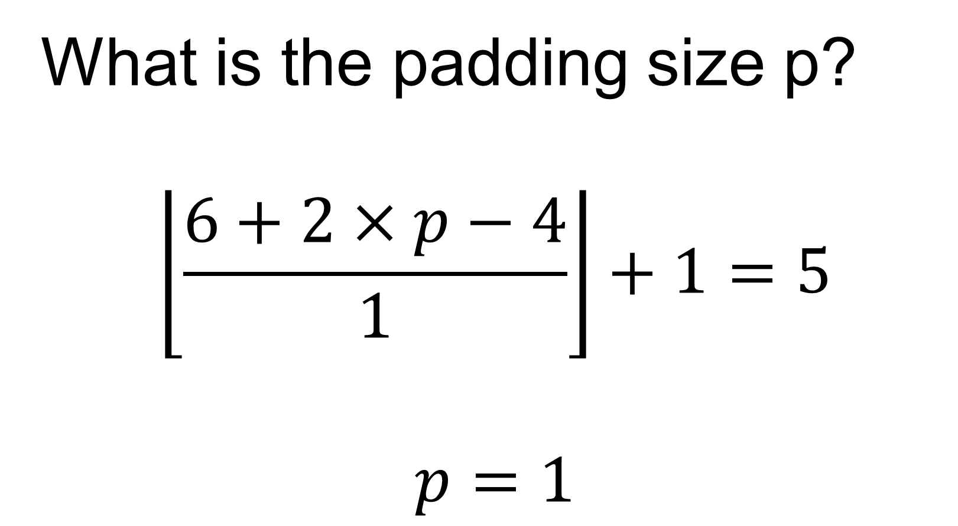
Transpose convolution
Increase image size after convolution – often used to upsample feature maps
Input: 6x6, padding 0, stride 1
Kernel: 4x4
Required Output:5x5
Determine padding size
Sliding over the output
For every location in output, take the corresponding pixels in input maps and apply the kernel
What is the padding size p?
$$\left\lfloor \frac{6+2×p−4}{1}\right\rfloor +1=5$$
$$p=1$$
Animation is from https://github.com/vdumoulin/conv_arithmetic

Slide 31
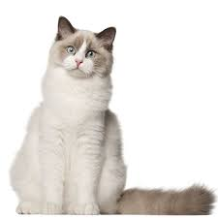
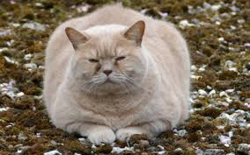
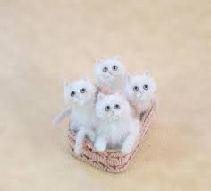
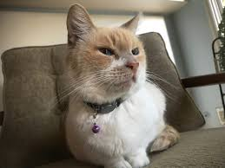
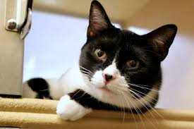
Convolution is shift-invariant, not for rotation and scale
CONV cannot deal with arbitrary spatial transformation
More general, the training and test sets can have different distribution
conv
conv
Training set, cats are roughly the same size
A test sample, small cat

Slide 32
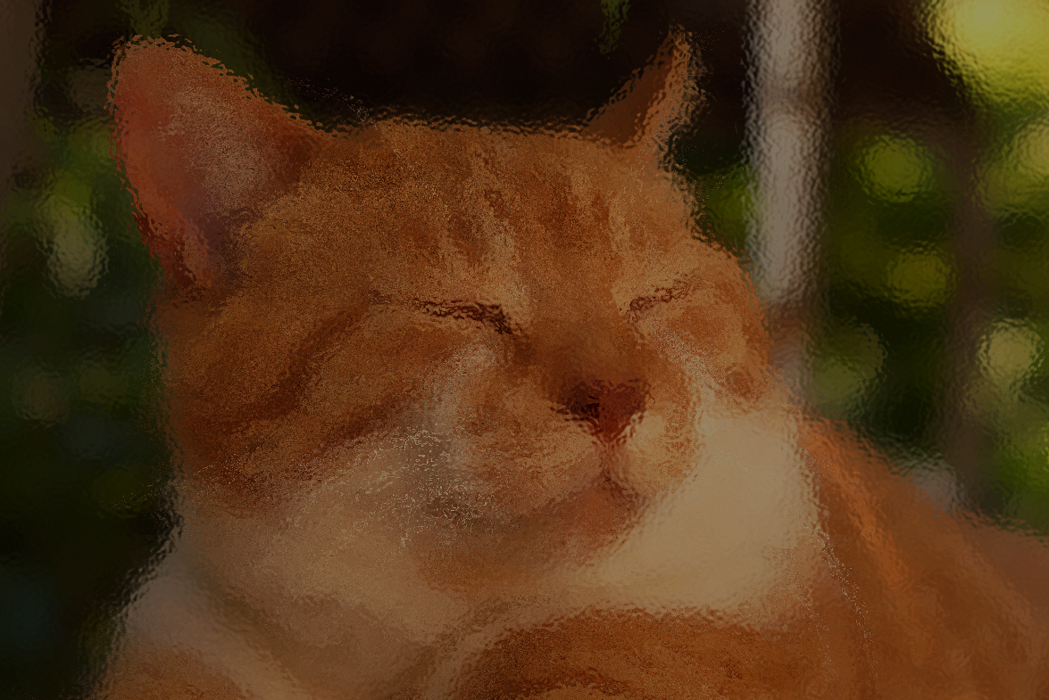

Data augmentation
Introduce variation in the training data, so model can learn invariance
Randomly apply different transformations
And many more …
Check http://ai.stanford.edu/blog/data-augmentation/

Slide 33
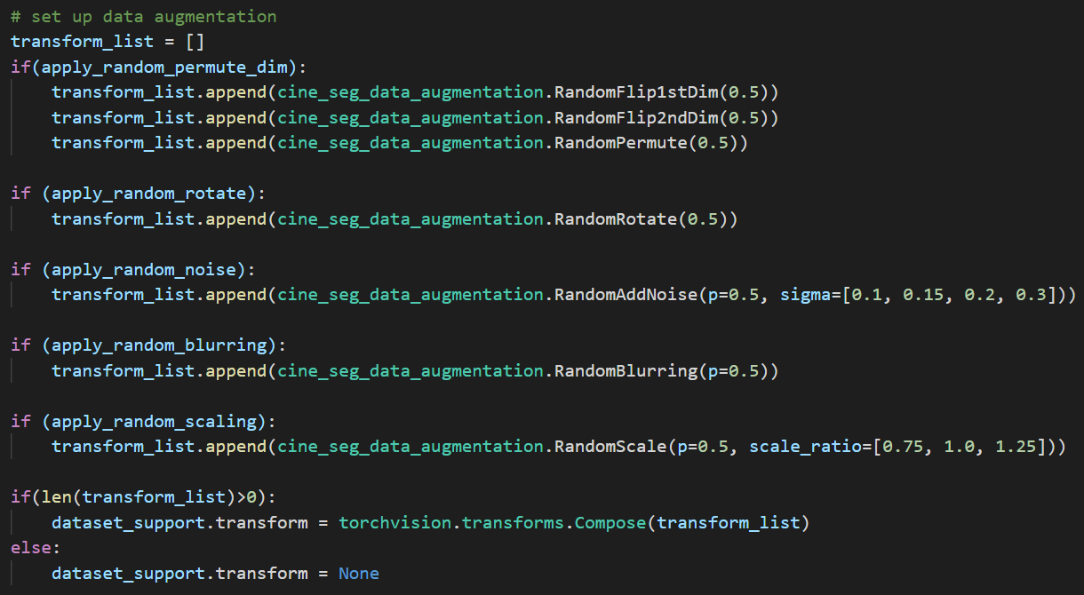

Data augmentation
Do not generate these random samples and save them
Instead, implement them as a part of data loading
T₁
_{P=0.5}
T₂
_{P=0.8}
T₃
_{P=0.2}
T_{N}
_{P=0.5}
… …
Input to training
P: probability to apply the transformation
More examples can be found at https://pytorch.org/vision/stable/auto_examples/plot_transforms.html#sphx-glr-auto-examples-plot-transforms-py

Slide 34
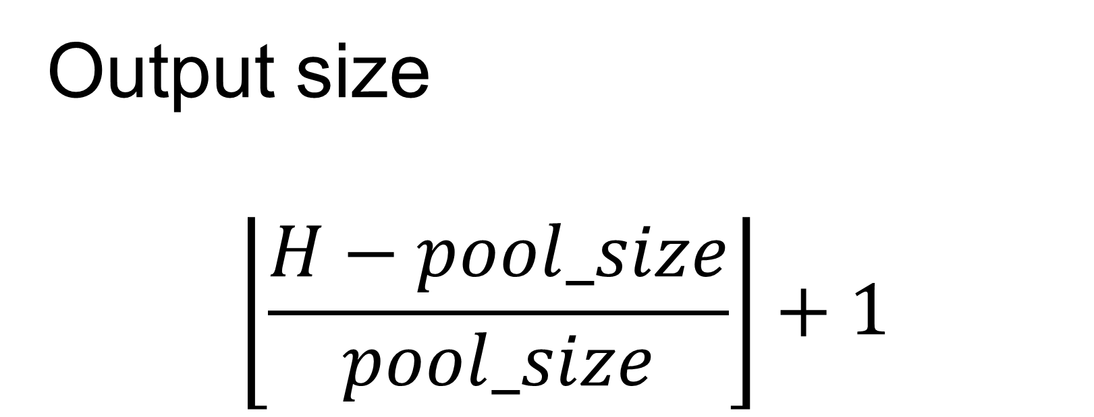
Pooling : another way to reduce computation
Often used to reduce the image size
Parameter free
Input: 8x8
Pool size: 2x2
Take every 2x2 neighborhood, compute its max (max pool) or average (averaging pool)
Typically, no padding, stride equals to the pool_size
0 | 0 | 0 | 0 | 0 | 0 | 0 | 0
0 | 1 | 1 | 1 | 1 | 1 | 1 | 0
0 | 1 | 2 | 2 | 2 | 2 | 1 | 0
0 | 1 | 2 | 3 | 3 | 2 | 1 | 0
0 | 1 | 2 | 3 | 3 | 2 | 1 | 0
0 | 1 | 2 | 2 | 2 | 2 | 1 | 0
0 | 1 | 1 | 1 | 1 | 1 | 1 | 0
0 | 0 | 0 | 0 | 0 | 0 | 0 | 0
1
Max pool
Output size
$$\left\lfloor \frac{H−pool_size}{pool_size}\right\rfloor +1$$

Slide 35
Pooling : another way to reduce computation
Often used to reduce the image size
Parameter free
Input: 8x8
Pool size: 2x2
Take every 2x2 neighborhood, compute its max (max pool) or average (averaging pool)
Typically, no padding, stride equals to the pool_size
0 | 0 | 0 | 0 | 0 | 0 | 0 | 0
0 | 1 | 1 | 1 | 1 | 1 | 1 | 0
0 | 1 | 2 | 2 | 2 | 2 | 1 | 0
0 | 1 | 2 | 3 | 3 | 2 | 1 | 0
0 | 1 | 2 | 3 | 3 | 2 | 1 | 0
0 | 1 | 2 | 2 | 2 | 2 | 1 | 0
0 | 1 | 1 | 1 | 1 | 1 | 1 | 0
0 | 0 | 0 | 0 | 0 | 0 | 0 | 0
1 | 1 | 1 | 1
1 | 3
Max pool
Output size
$$\left\lfloor \frac{H−pool_size}{pool_size}\right\rfloor +1$$

Slide 36
Pooling : another way to reduce computation
Often used to reduce the image size
Parameter free
Input: 8x8
Pool size: 2x2
Take every 2x2 neighborhood, compute its max (max pool) or average (averaging pool)
Typically, no padding, stride equals to the pool_size
0 | 0 | 0 | 0 | 0 | 0 | 0 | 0
0 | 1 | 1 | 1 | 1 | 1 | 1 | 0
0 | 1 | 2 | 2 | 2 | 2 | 1 | 0
0 | 1 | 2 | 3 | 3 | 2 | 1 | 0
0 | 1 | 2 | 3 | 3 | 2 | 1 | 0
0 | 1 | 2 | 2 | 2 | 2 | 1 | 0
0 | 1 | 1 | 1 | 1 | 1 | 1 | 0
0 | 0 | 0 | 0 | 0 | 0 | 0 | 0
1 | 1 | 1 | 1
1 | 3 | 3 | 1
1 | 3 | 3 | 1
1 | 1 | 1 | 1
Max pool
Output size
$$\left\lfloor \frac{H−pool_size}{pool_size}\right\rfloor +1$$
2x2 is the most typical choice

Slide 37
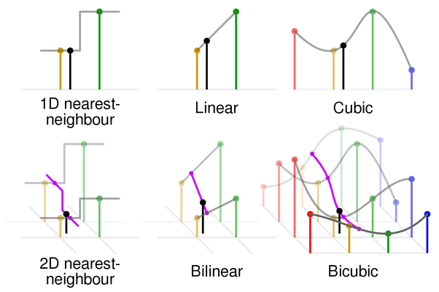
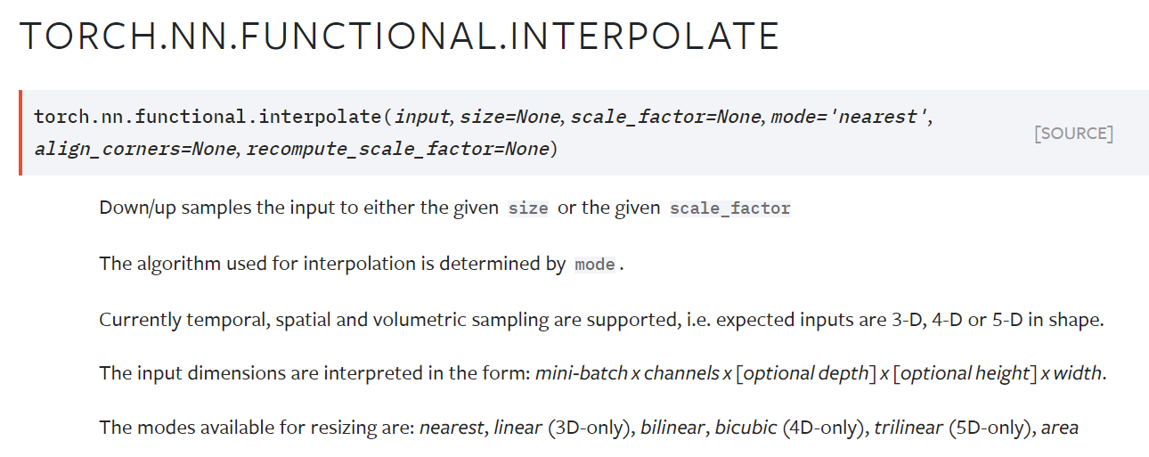
Use interpolation to resize images
Another “parameter free” way to resize images
It is a layer in NN
Differentiable by remembering the interpolation weights
Interpolation: use neighboring pixels to determine value of unknown location (weighted sum)
Weights depend on pixel location; no learnable parameters
https://www.quora.com/What-is-bicubic-interpolation-in-image-processing

Slide 38
Layers to adjust image size
Layers | Downsample | Upsample | Pro/Cons
Stride CONV | Yes | No | Same as normal conv, fast to compute
Pooling | Yes | No | Fast to compute, reduce the model power, less popular nowadays
Interpolation | Yes | Yes | Parameter free, fast to compute
Transpose CONV | Yes, but often not used for this | Yes | Has learnable parameters for upsampling
Pooling still is used in classification tasks
Full CONV architecture are more popular for other tasks, e.g. segmentation, super-resolution, denoising …

Slide 39
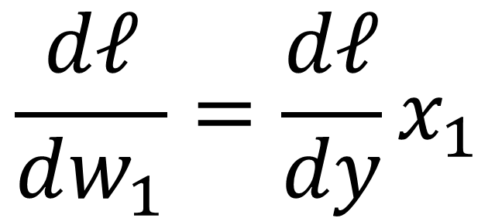
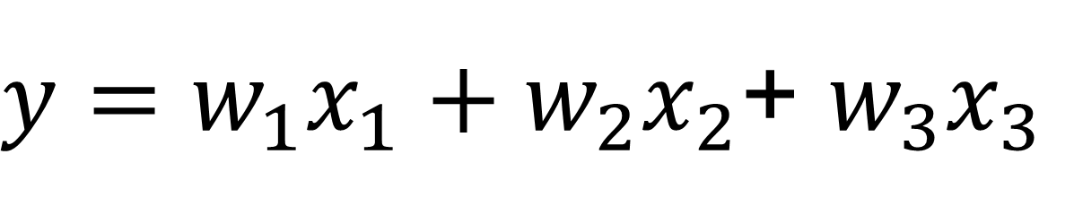


Batch Normalization
Features with varying magnitude
Features with normalized magnitude
$$\frac{dℓ}{dw_{1}}=\frac{dℓ}{dy}x_{1}$$
$$\frac{dℓ}{dw_{3}}=\frac{dℓ}{dy}x_{3}$$
Features with unnormalized magnitude leads to harder optimization
$y=w_{1}x_{1}+w_{2}x_{2}$+ $w_{3}x_{3}$
$$\frac{dℓ}{dw_{2}}=\frac{dℓ}{dy}x_{2}$$

Slide 40
Batch Normalization
Techniques to battle unnormalized features
Data pre-processing, whitening …
Model parameter initialization (e.g. He and Xavier)
Model will be well-behaved at the beginning of training
No guarantee for later epochs
No guarantee for deeper layers
Almost guaranteed to deviate
CONV
ReLU
CONV
ReLU
CONV
ReLU
Flatten
FC
ReLU
FC
logits
Normalized after data pre-processing
Output of previous layer is the input to the next layer
Deviated from normalized features

Slide 41





Batch Normalization: if we need normalized features, add a layer to enforce it
Add a specific layer to normalize the output of previous layer
Give a mini-batch, $X=\left\{\begin{matrix}x^{\{1\}} & x^{\{2\}} & x^{\{3\}}\end{matrix} \begin{matrix}⋯ & ⋯ & x^{\{B\}}\end{matrix}\right\}$
Every sample $x^{\{k\}}$ is a Nx1 vector or CxHxW image
${\hat{x}}^{\{k\}}$ is the Nx1 vector, same as $x^{\{k\}}$
$μ$ and $δ$ are per-dimension mean and variance
Compute mean of this batch
Compute variance of this batch
$$μ=\frac{1}{B}\sum_{k=1}^{B}{x^{\{k\}}}$$
$$δ^{2}=\frac{1}{B}\sum_{k=1}^{B}{{\left[x^{\{k\}}−μ\right]}^{2}}$$
Normalize the batch
$${\hat{x}}^{\{k\}}=\frac{x^{\{k\}}−μ}{\sqrt[2]{δ^{2}+ε}}$$
Element-wise operation
Batch Normalization: Accelerating Deep Network Training by Reducing Internal Covariate Shift. https://arxiv.org/abs/1502.03167

Slide 42








Batch Normalization: if we need normalized features, add a layer to enforce it
Give a mini-batch, $X=\left\{\begin{matrix}x^{\{1\}} & x^{\{2\}} & x^{\{3\}}\end{matrix} \begin{matrix}⋯ & ⋯ & x^{\{B\}}\end{matrix}\right\}$
$x^{\{k\}}$ is a Nx1 vector or CxHxW image
Normalization reduces the representation power of model
To restore the representation power, introduce two learnable parameters
$$μ=\frac{1}{B}\sum_{k=1}^{B}{x^{\{k\}}}$$
$$δ^{2}=\frac{1}{B}\sum_{k=1}^{B}{{\left[x^{\{k\}}−μ\right]}^{2}}$$
At training time,
Given a mini-batch, compute mean and variance
Compute $\hat{x}$ and $y$, using $γ$ and $β$ and $μ$ and $δ$
Therefore, if batch size is too small (e.g. <16), BN may not work well
$${\hat{x}}^{\{k\}}=\frac{x^{\{k\}}−μ}{\sqrt[2]{δ^{2}+ε}}$$
$γ$ and $β$ are the same dimension as $x^{\{k\}}$
$$y^{\{k\}}=γ∘{\hat{x}}^{\left\{k\right\}}+β$$
${\hat{x}}^{\{k\}}=$ $x^{\{k\}}$ if $γ=$ $δ$and $β=μ$
Batch Normalization: Accelerating Deep Network Training by Reducing Internal Covariate Shift. https://arxiv.org/abs/1502.03167

Slide 43









Batch Normalization: if we need normalized features, add a layer to enforce it
At training time,
Given a mini-batch, compute $μ$ and $δ$ from this batch
Compute $\hat{x}$ and $y$, using $γ$ and $β$ and $μ$ and $δ$
At test time,
We don’t have a mini-batch, often B=1
The assumption behind BN is the statistics from a batch can approximate the entire dataset
Test and training datasets have the same distribution
$$μ=\frac{1}{B}\sum_{k=1}^{B}{x^{\{k\}}}$$
$$δ^{2}=\frac{1}{B}\sum_{k=1}^{B}{{\left[x^{\{k\}}−μ\right]}^{2}}$$
or, $\overline{μ}$ and $\overline{δ}$ can be computed as simple average for all trained batches
$${\hat{x}}^{\{k\}}=\frac{x^{\{k\}}−μ}{\sqrt[2]{δ^{2}+ε}}$$
$\overline{μ}=$ $(1−α)\overline{μ}+αμ$
$$\overline{δ}=(1−α)\overline{δ}+αδ$$
$$y^{\{k\}}=γ∘{\hat{x}}^{\left\{k\right\}}+β$$
$α=0.1$
Batch Normalization: Accelerating Deep Network Training by Reducing Internal Covariate Shift. https://arxiv.org/abs/1502.03167

Slide 44


Spatial Batch Normalization for CONV
Batch Normalization
Spatial Batch Normalization
BxN
BxCxHxW
Normalize along BxHxW
Normalize along B
BxN
BxCxHxW
$γ,β$: [Nx1] learnable parameters
$γ,β$: [Cx1] learnable parameters
e.g. torch.nn.BatchNorm2d
Batch Normalization: Accelerating Deep Network Training by Reducing Internal Covariate Shift. https://arxiv.org/abs/1502.03167

Slide 45
Model with BN layer
CONV
BN
ReLU
CONV
BN
ReLU
CONV
BN
ReLU
Flatten
FC
BN
ReLU
FC
Often lead to faster and more stable convergence
Less sensitive to parameter initialization
Less sensitive to hyper-parameter setting
Allow flexible selection of nonlinearity functions
Has regularization effect → introduce randomness in training
Do not use with drop-out
Can hide bugs in the code – debug by turning BN on/off
logits
Make more sense since ReLU causes unbalanced distribution
CONV
ReLU
BN
CONV
ReLU
BN
CONV
ReLU
BN
Flatten
FC
ReLU
BN
FC
logits
Make more sense since BN normalizes both CONV and ReLU

Slide 46

From BN paper
Accuracy
Test on ImageNet 2012 dataset with the inception network
BN-x5, x30 is to increase learning rate by 5 times or 30 times → BN allows to use larger learning rate → faster convergence
BN-x5-Sigmoid shows BN allows to use sigmoid activation function. Without BN, sigmoid activation does not lead to convergence
BN-x30 got higher accuracy than BN-x5 → exploration
Number of training steps
Batch Normalization: Accelerating Deep Network Training by Reducing Internal Covariate Shift. https://arxiv.org/abs/1502.03167

Slide 47


Model evaluation and training
Do not forget to set model be in evaluation mode, so the moving averaged mean and standard deviation will not be updated
When doing training, set model to be in training mode, so the moving averaged mean and standard deviation will be updated
A common source of error

Slide 48


More feature normalization
Group Normalization. https://arxiv.org/pdf/1803.08494.pdf
https://medium.com/techspace-usict/normalization-techniques-in-deep-neural-networks-9121bf100d8

Slide 49

CNN leads to the revolution of deep learning
Deep learning revolution started in 2012 with AlexNet
Its origin were long back in time
LeNet 1989 or earlier
CNN architecture development was well tracked by ImageNet winners
What was learned was adapted to other applications
When deep learning revolution started
Figure is from http://cs231n.stanford.edu/slides/2021/lecture_9.pdf

Slide 50

LeNet and MNIST datasets
The MNIST database of handwritten digits, available from this page, has a training set of 60,000 examples, and a test set of 10,000 examples. It is a subset of a larger set available from NIST. The digits have been size-normalized (28x28) and centered in a fixed-size image.
- http://yann.lecun.com/exdb/mnist/
Modified National Institute of Standards and Technology database
EMNIST has been published in 2017, which contains 240,000 training images, and 40,000 testing images of handwritten digits and characters.
Y. LeCun, L. Bottou, Y. Bengio and P. Haffner: Gradient-Based Learning Applied to Document Recognition, Proceedings of the IEEE, 86(11):2278-2324, November 1998

Slide 51
LeNet-5
CONV1
tanh
Ave Pool
CONV2
tanh
Ave Pool
Flatten
FC1
tanh
FC2
tanh
FC3
While the architecture of the best performing neural networks today are not the same as that of LeNet, the network was the starting point for a large number of neural network architectures, and also brought inspiration to the field.
- https://en.wikipedia.org/wiki/LeNet
logits
Input : Bx1x28x28 | Output
CONV1: 5x5, padding 2, stride 1, K = 6 | Bx6x28x28
Ave pool: 2x2 | Bx6x14x14
CONV2: 5x5, padding 0, stride 1, K = 16 | Bx16x10x10
Ave pool: 2x2 | Bx16x5x5
FC1: D=120 | Bx120
FC2: D=84 | Bx84
FC3: D=10 | Bx10
~60K parameters
Backprop to train CONV
Use ave pooling
Use tanh
Use flatten and FC
Use softmax and CE loss
Increase number of filters with reduced spatial resolution
Used by the USPS, maybe the first deployed cnn?
LeCun, Y.; Boser, B.; Denker, J. S.; Henderson, D.; Howard, R. E.; Hubbard, W. & Jackel, L. D. (1989). Backpropagation applied to handwritten zip code recognition. Neural Computation, 1(4):541-551.

Slide 52

ImageNet Large Scale Visual Recognition Challenge (ILSVRC)
Running since 2010, currently still run in Kaggle
https://image-net.org/challenges/LSVRC/index.php
https://www.kaggle.com/c/imagenet-object-localization-challenge/overview/description
https://www.paperswithcode.com/sota/image-classification-on-imagenet?metric=Top%205%20Accuracy
ILSVRC used 1.2 million training images for 1000 classes, 50,000 validation images, and 150,000 testing images
Include object classification, detection and video detection tasks
ImageNet is a dataset of over 15 million labeled high-resolution images belonging to roughly 22,000 categories
Object localization for 1000 categories.
Object detection for 200 fully labeled categories.
Object detection from video for 30 fully labeled categories.
LeCun, Y.; Boser, B.; Denker, J. S.; Henderson, D.; Howard, R. E.; Hubbard, W. & Jackel, L. D. (1989). Backpropagation applied to handwritten zip code recognition. Neural Computation, 1(4):541-551.

Slide 53
AlexNet
CONV1
ReLU
Max Pool
CONV2
ReLU
Max Pool
CONV3
ReLU
CONV4
ReLU
CONV5
ReLU
Max Pool
Flatten
FC1
ReLU
FC2
ReLU
FC3
Logits
Bx1000
Bx3x227x227
Input : Bx3x227x227 | Output
CONV1: 11x11, padding 0, stride 4, K = 96 | Bx96x55x55
Max pool: 3x3, stride 2 | Bx96x27x27
CONV2: 5x5, padding 2, stride 1, K = 256 | Bx256x27x27
Max pool: 3x3, stride 2 | Bx256x13x13
CONV3: 3x3, padding 1, stride 1, K = 384 | Bx384x13x13
CONV3: 3x3, padding 1, stride 1, K = 384 | Bx384x13x13
CONV3: 3x3, padding 1, stride 1, K = 256 | Bx256x13x13
Max pool: 3x3, stride 2 | Bx256x6x6
FC2: D=4096 | Bx4096 (~62% of total #paras)
FC1: D=4096 | Bx4096
FC3: D=1000 | Bx1000
~60K 61M parameters
Backprop to train CONV
Use ave max pooling
Use tanh ReLU
Use flatten and FC
Use softmax and CE loss
Increase number of filters with reduced spatial resolution
Much bigger
Data augmentation
Use GPU for training
Much larger dataset
Training and network architecture
Alex Krizhevsky, Ilya Sutskever, Geoffrey E. Hinton. ImageNet Classification with Deep Convolutional Neural Networks. NeuIPS 2012.

Slide 54
To be continued …
… …

